Slide 1

Travel without traveling
WAYANAD – The Paddy Field

Slide 2
Wayanad – Introduction
Facts
Places to visit
How to reach?
When to visit?
What to eat?

Slide 3
Wayanad - Introduction
Wayanad is an Indian district in the north-east of Kerala state
It got it’s name from combined two Malayalam word “Vayal” and “Nadu” which mean “paddy field”.
It has wide variety of tourist attractions like religious sites, historical sites and other natural sites.
Wayanad is bordered by Karnataka (Kodagu and Mysore) and Tamilnadu (Ooty)
It is located in western ghat ranges with altitudes from 700 to 2100 meters

Slide 4
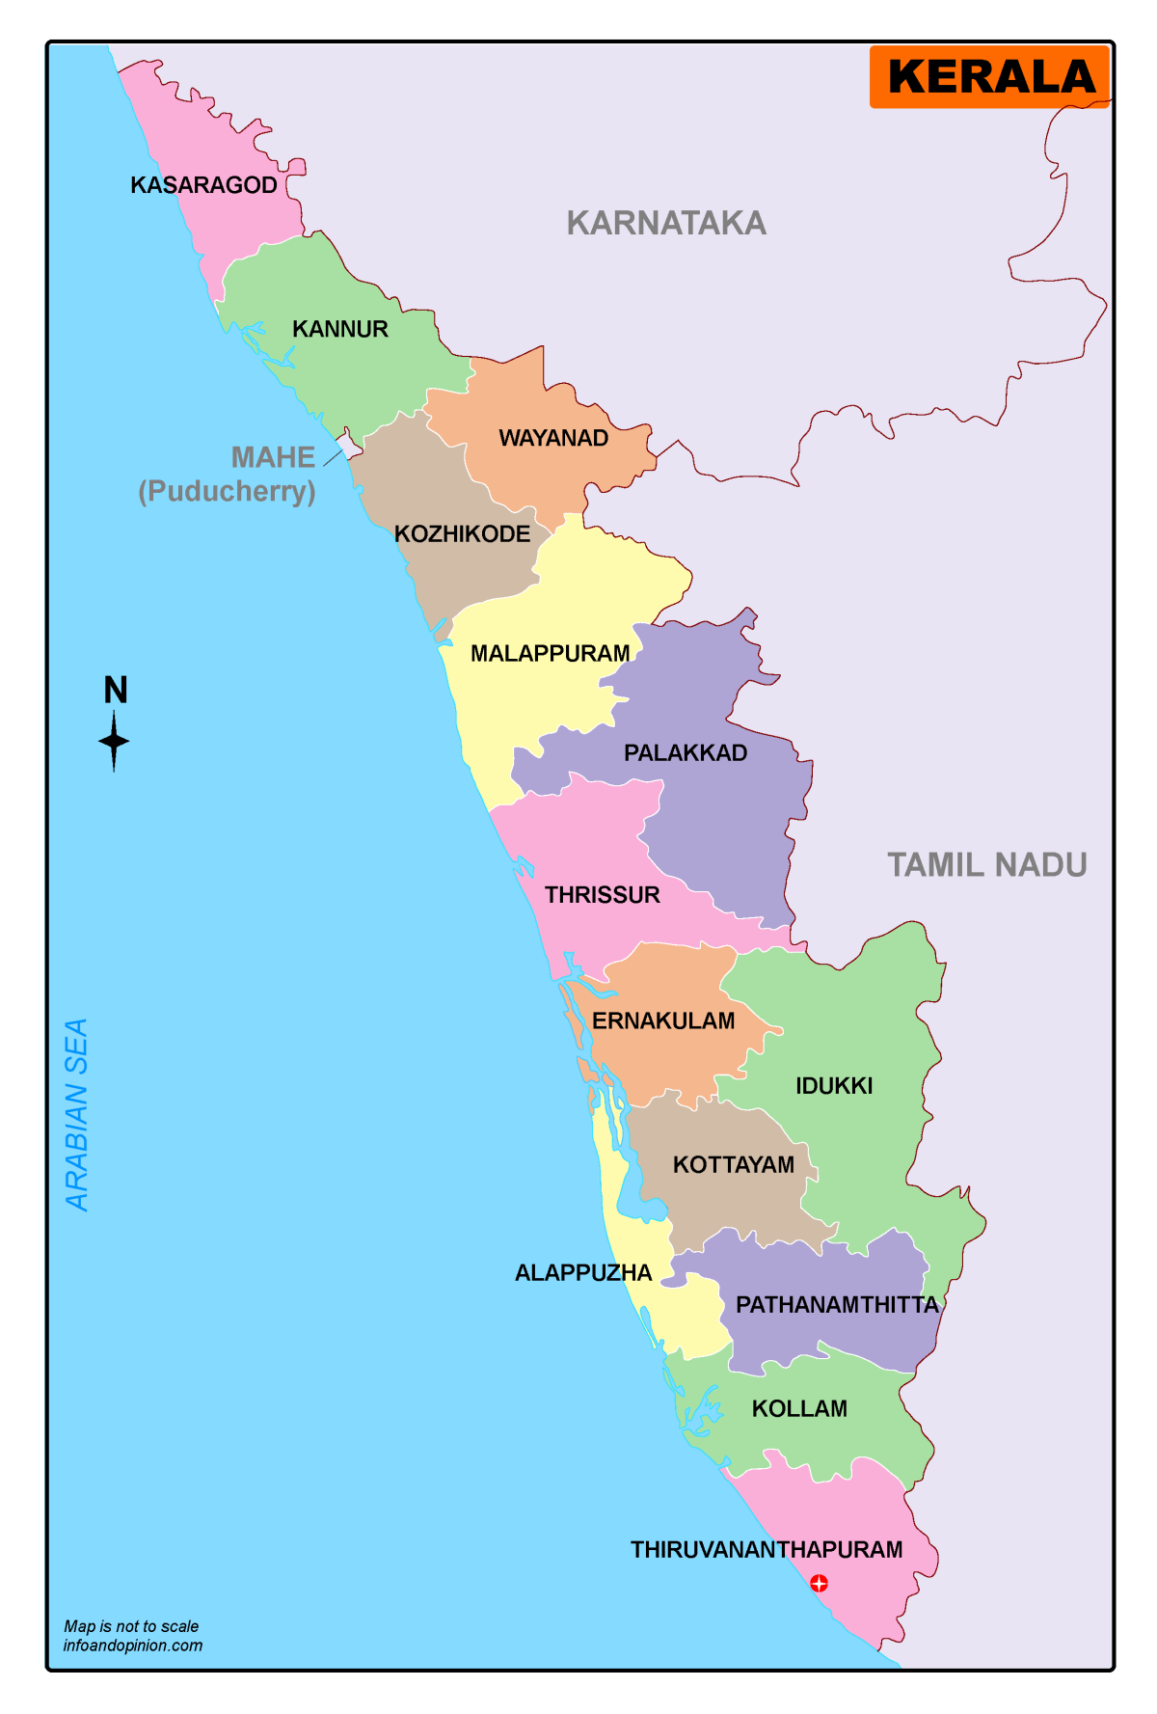
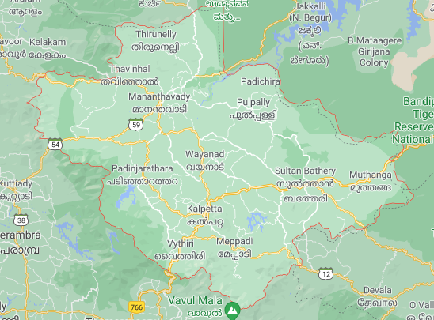
Wayanad
Arab
I
An
Sea

Slide 5
Facts about Wayanad
Wayanad is the only plateau that is in southern tip of Deccan plateau
The Kabini river which is the tributary of Kaveri river originates at Wayanad
First and largest earth dam is situated here…
The famous heart-shaped lake is located in Chembra peak..

Slide 6
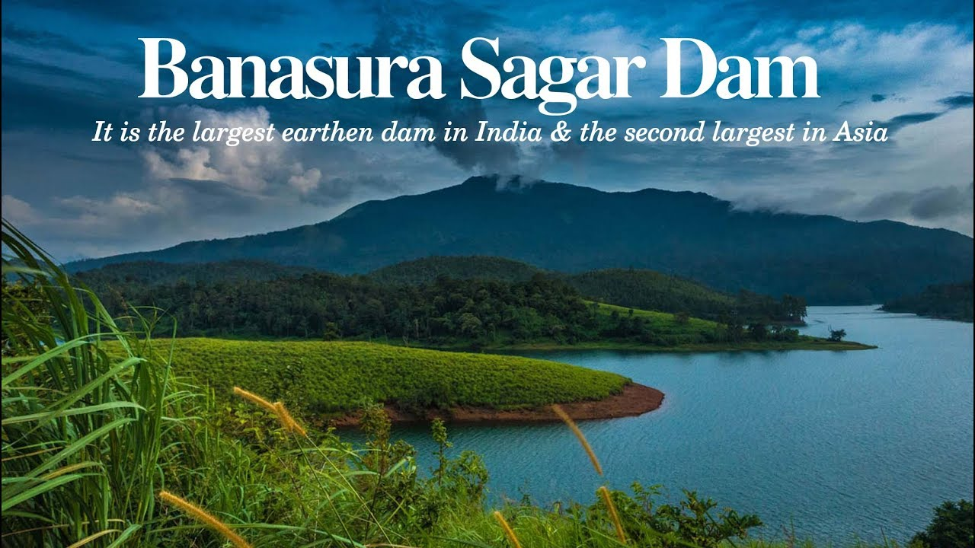
It is the first and largest Earth dam in India
Earth dam: It is typically created by the placement and compaction of a complex semi-plastic mound of various compositions of soil, sand, clay, or rock

Slide 7
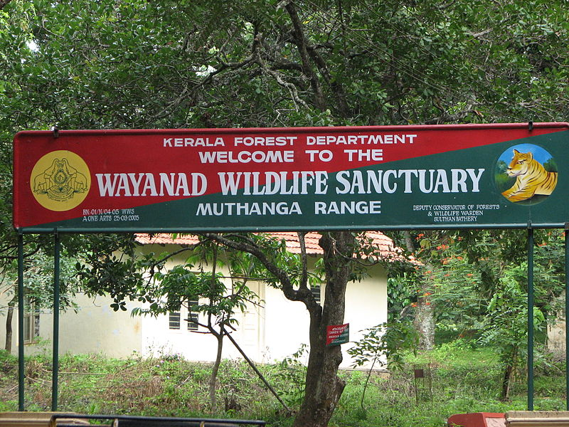
Wayanad wildlife sanctuary
home to animals including Asiatic elephants, tigers, leopards, deer and….

Slide 8
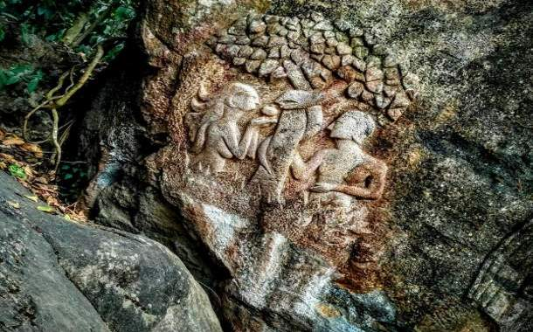
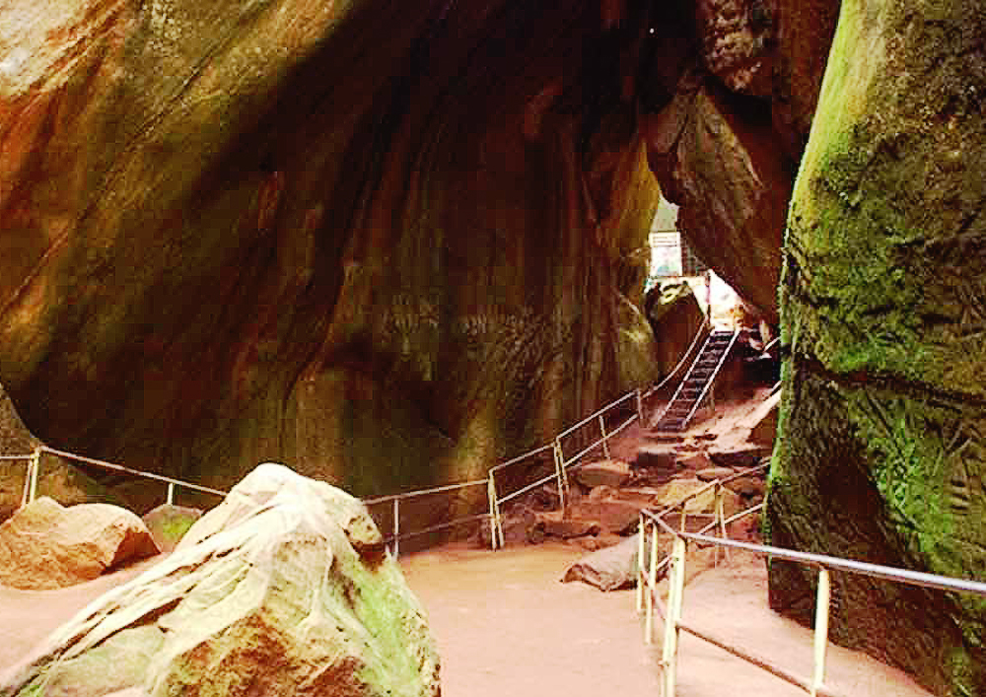
Edakkal caves
The Edakkal caves are famous for their paintings of: humans, animals, symbols and letters…

Slide 9
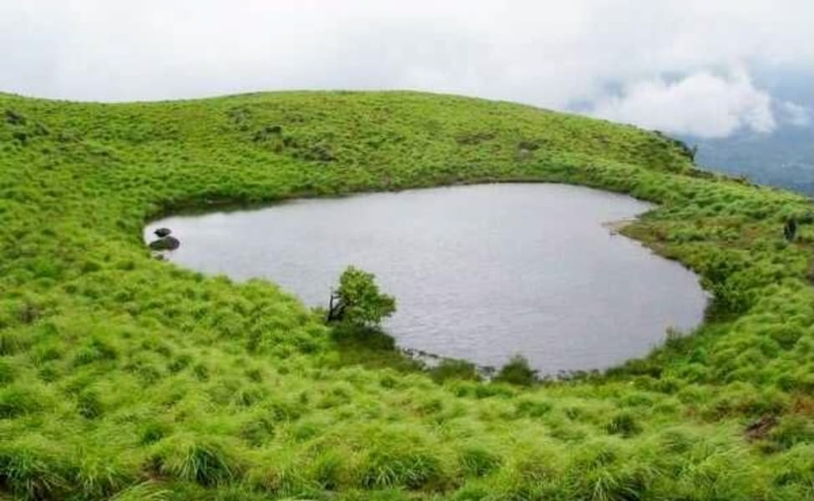
Chembra peak
The famous heart-shaped lake can be seen here in this peak which is at 2100m above sea level
One can reach this place by trekking for an hour or two…

Slide 10
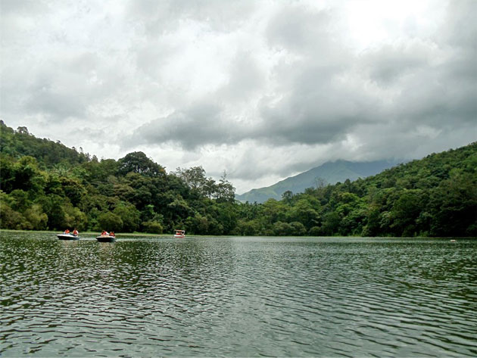
Pookode lake
Natural freshwater lake…

Slide 11
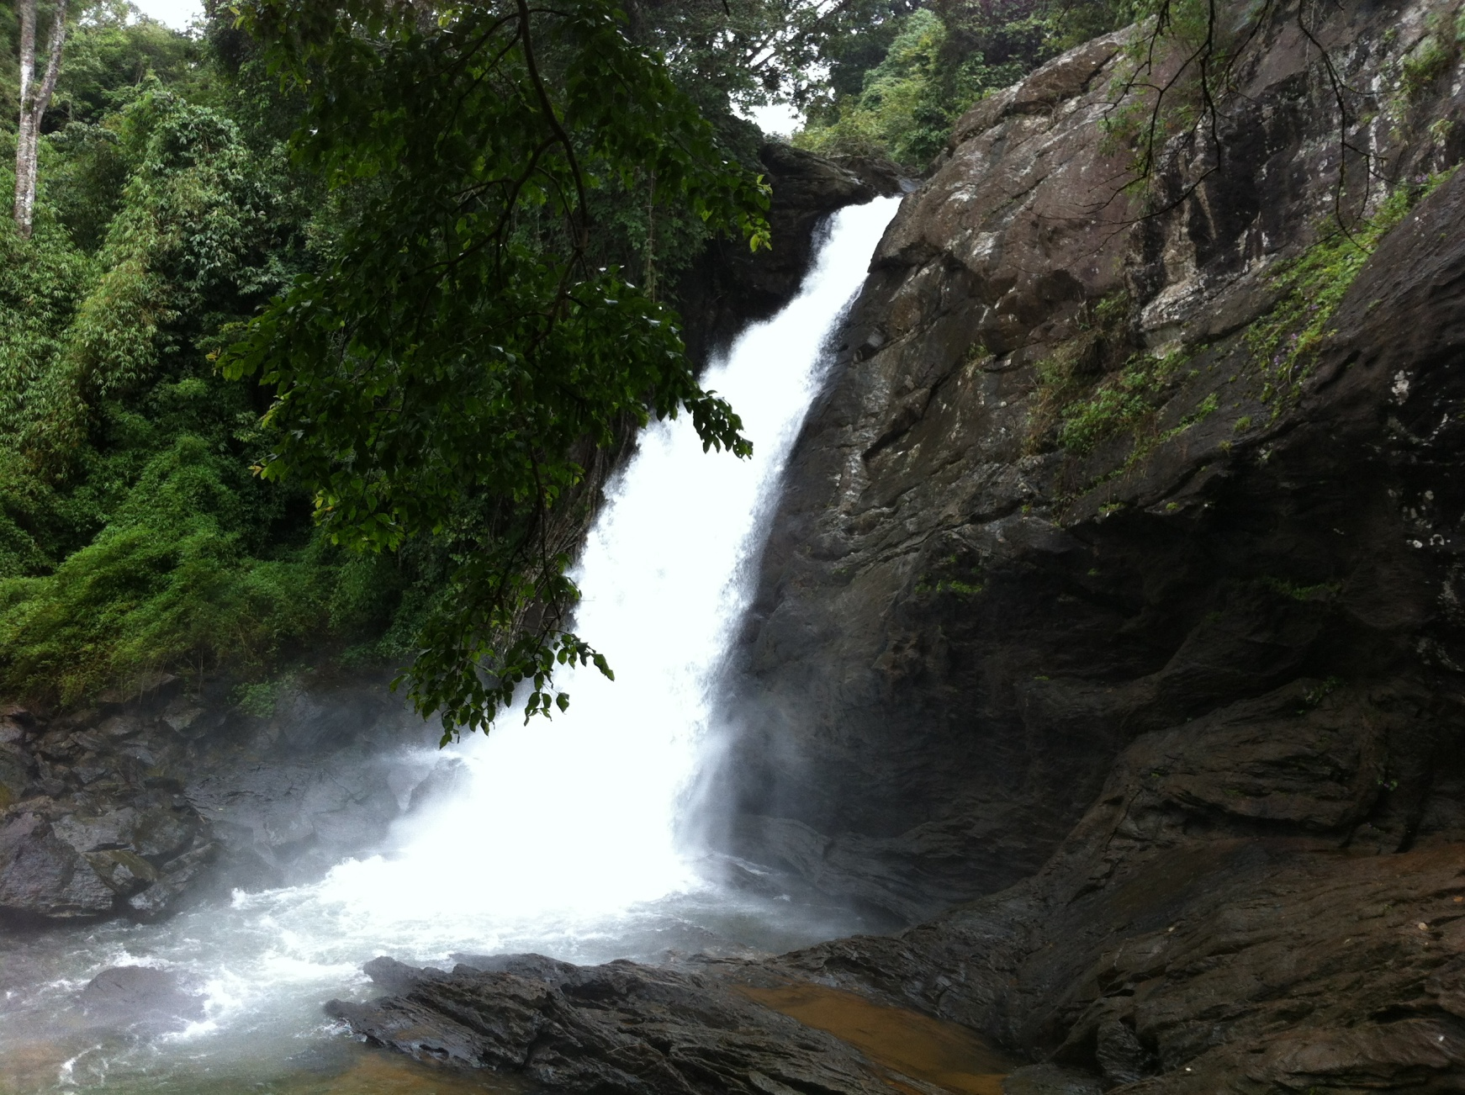
Soojipara falls

Slide 12
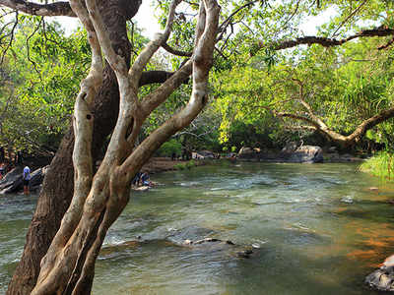
Kuruva Dweep / Island

Slide 13

Thirunelli temple

Slide 14
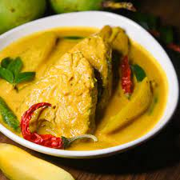

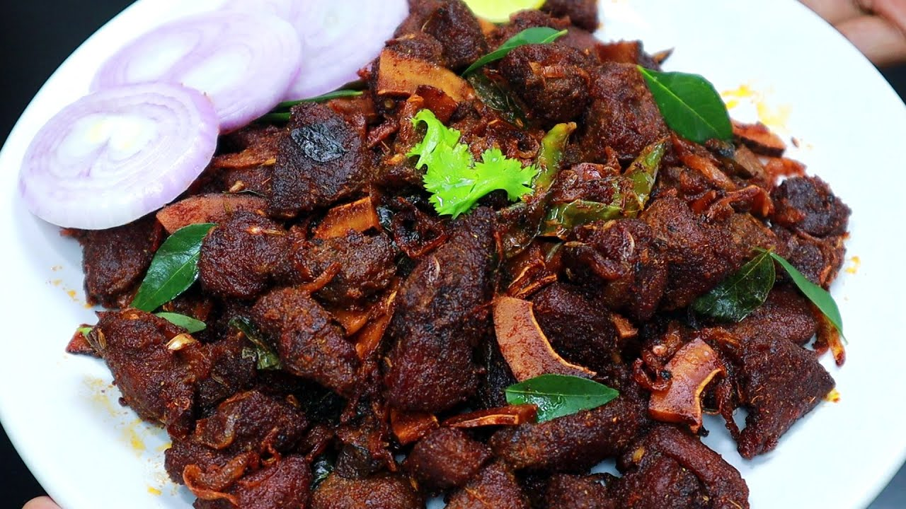
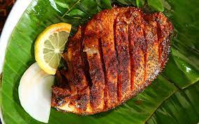
What to eat?
Fish Moilee
Appam & chicken stew
Nadan beef fry
Karimeen pollichathu

Slide 15
When to visit Wayanad
Best time to visit Wayanad
March to May (Summer) 25-35 °Celsius
June to September (Monsoon) 24-31 °Celsius

Slide 16
How to reach Wayanad
You can reach Wayanad by flight and by road
Travel through different routes by road
Mysore – Gundlupete – Sulthan Bathery – Wayanad
Mysore – Hunsur – Nagarahole – Tholpatty – Wayanad

Slide 17
Thank You

